Slide 1


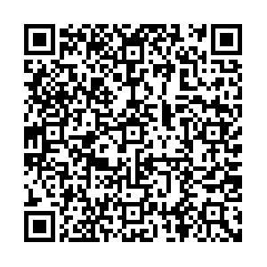
SCHOLARSHIP MEETING #1
WELCOME!
Quick Link to Career page
/Finance & Awards:

Slide 2
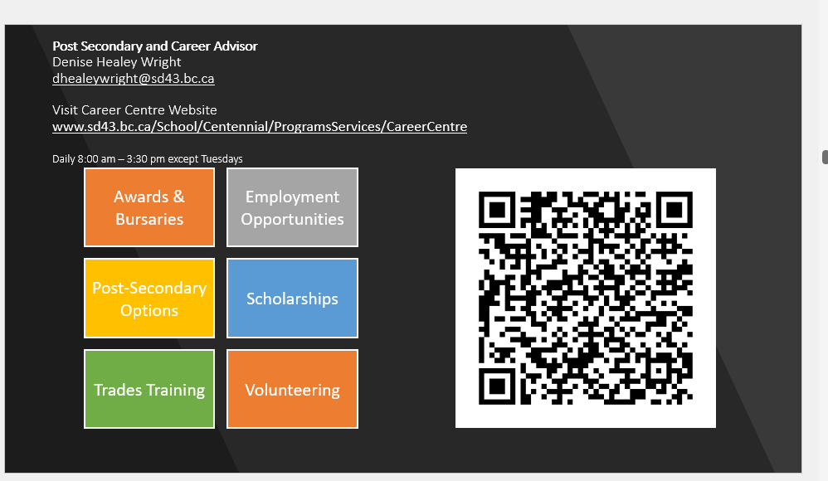
Thursdays

Slide 3
Eligibility:*Graduating students*Canadian Citizenship, Permanent Resident or Landed Immigrant Status, Protected persons/Refugees will fulfill most requirements and criteria.
**International Students do not meet this requirement.
There are a few sources of funding for International students via government agencies, post-secondary institutions and other donors.
INTRODUCTION
AWARDS/DEFINITIONS
Major Awards (High value/Merit based)
Post- Secondary Entrance Awards
Service Based Scholarships
Government/Ministry Awards District Authority Awards
Centennial Local Scholarship Package (2025) Meeting #2 on February 13th.
Due in April, 2025 tbd
DEFINING NEED
Cost of tuition. Financial Aid
APPLICATION STRATEGIES
Personal Essay Personal Profile
POST SECONDARY APPLICATIONS

Slide 4
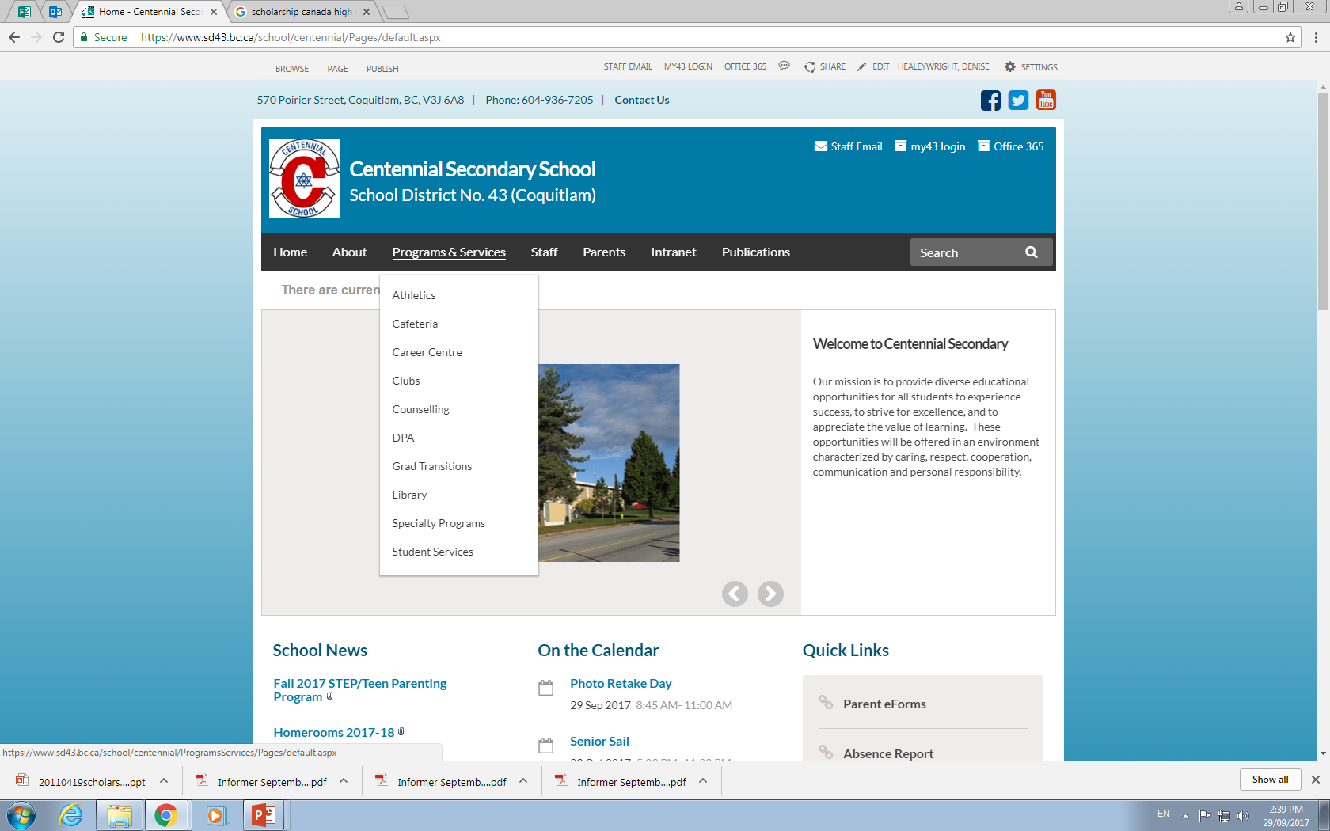
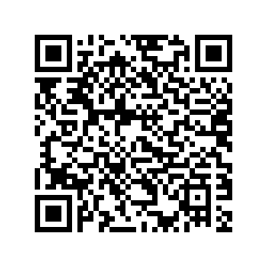

Slide 5
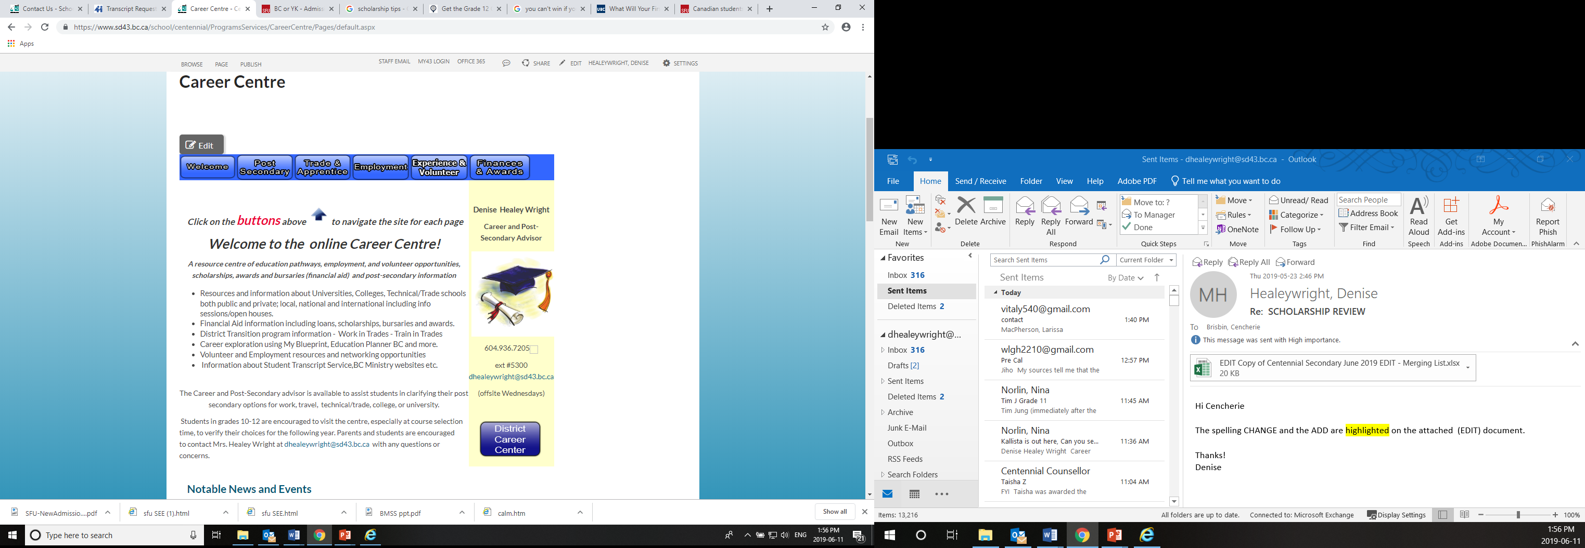
Select buttons for information and links regarding Financial Aid & Awards (Scholarships/ Bursaries)
Also Employment, Volunteering and Post-Secondary Information and info sessions.

Slide 6
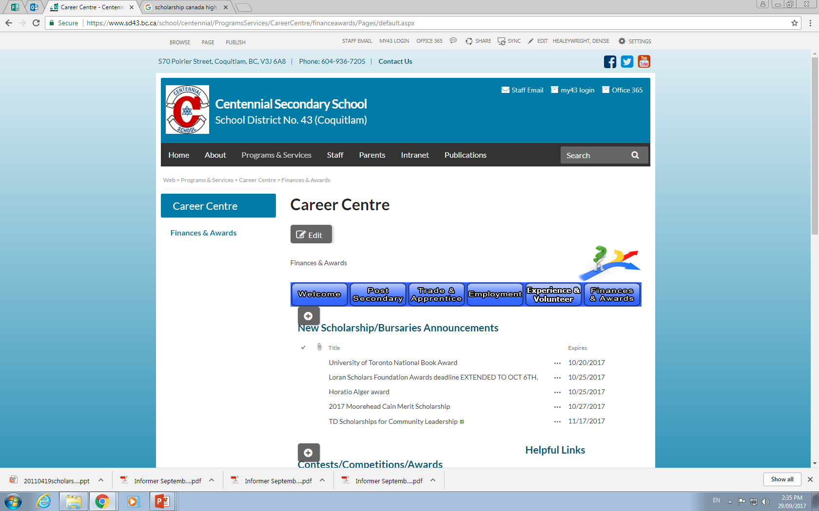
SCHOLARSHIPS ARE LISTED here
Click on each award
listing for details!

Slide 7
FAQ’s
WHEN should I apply for scholarships?
Start research NOW for Entrance Scholarships and National/Major Awards
However, many scholarship deadlines occur within the months of February-May

Slide 8
SCHOLARSHIPS, BURSARIES & AWARDS - AN OVERVIEW
Financial aid is not the same as Financial need
Financial Aid:
Monetary support, as a loan or scholarship, that is used to pay for school, especially higher education:
“I don’t qualify for need-based financial aid, so I’ll have to hope I’m awarded a merit-based achievement, community service and/or leadership awards.”
Financial Need
The difference between the cost of an educational program and what the student can afford to pay. One's financial need may qualify one for grants, scholarships, or low-interest loans. Otherwise, the student must borrow or save. Parental & student annual income is considered.

Slide 9
Sample Costs of Post Secondary
College:
Douglas College: First year full time Tuition can range from $5,000 to $13,000 per year including Fees & Books- depending on choice of program and whether you live at home.
University:
UBC approx $22,000 per year full load, (including living on campus (shared), meal plan) books fees and living expenses.
Private colleges and universities are usually twice the tuition of public institutions.
Trades
Foundation programs (24 weeks on average) $2K to $4 plus gear.

Slide 10

Tailor your choices so your
post-secondary pathway is unique to YOU!!!

Slide 11



Post-Secondary Funding options:
Student Aid BC (re-payment)
For student loans there is an expectation that YOU and your parents will contribute some funds to your education! Talk to your parents about this.
Do research on the website http://www.studentaidbc.ca
Bank Loans (re-payment)
Savings from part-time and/or summer employment
REF (Registered Education Fund) or money from family
Scholarships
Awards
Bursaries (based on financial need/family income)

Slide 12

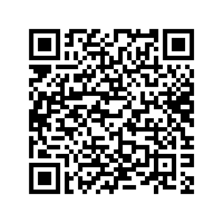
PROVINCIAL SCHOLARSHIP PROGRAM
BC Pathway to Teacher Education Scholarship $5,000
(20 awards available to students entering a Faculty of Education program)
BC Excellence Awards $5,000 One nominee
There are 55 BC Excellence Scholarships available to recognize well-rounded B.C. graduates. Winners will have demonstrated service and leadership, both at school and in their communities, and shown aptitude and commitment to their chosen career paths. They will receive a $5000 scholarship voucher to use for post-secondary tuition. DUE: Feb 15th
BC Achievement Scholarships $1,250 Automatic Students do not apply.
Recognize the top 8000 graduates in the province. The Ministry will determine recipients based on achievement in Grades 10, 11, and 12 courses that satisfy 2004 Graduation Program requirements, including elective courses. CLE will not be included.
A cumulative average percentage will be calculated and form the basis for determining winners, who receive a $1250 scholarship voucher to use towards their tuition.

Slide 13
District/Authority Awards $1250 - 35+ available for Centennial graduates. Apply within our local scholarship package in the spring.
The application will require teacher signature which verifies that you EXCEL in the focus area. Must be a Canadian citizen or permanent resident (landed immigrant) and have that on record with the school at which you registered for Grade 12 Be a B.C. resident. Valid for 5 years.
Superior Achievement/Excellence in one of the following areas:
• Fine Arts (Fine and Performing Arts: Art, Music, Drama, Voice etc.)
• Applied Skills
• Trades and Technology
• Physical Activity (community and/or school-based teams and/or provincial/national level)
•Curricular Second/international Languages
•District / Curricular Technical & Trades Training
•School & Community Service (min 150 hours to apply)
• Indigenous Languages and Culture
https://www2.gov.bc.ca/gov/content/education-training/k-12/support/scholarships/provincial-scholarships

Slide 14
Major Scholarships & Major Entrance Scholarships (Merit based)
Deadlines are early in the school year
Speak to your counsellor if you would like to considered for nomination.
If you meet the criteria for these awards, and do not require a nomination – APPLY
UNIVERSITIES AND COLLEGES ARE URGING STUDENTS who meet the criteria
TO APPLY FOR ENTRANCE AWARDS. Plenty of funding is available!!
Check your institutions for available awards for incoming students.
Sample Awards:
Loran Awards (October 15) Community service no nomination required
Horatio Alger Awards (October) Financial need
U of T National Scholarships & U of T Book Award (Sept 27th) (1) Merit – Apply to be our nominee
Lester B Pearson Int’l Student Scholarship (October 11) (1) Merit/Nomination - Apply to U of T by October 18, 2024
Queen’s University Entrance Award Chancellors (December) (3) Merit – Speak to your counsellor
SFU USES Entrance Awards DEC 15
UBC Centennial Scholars and Entrance awards Dec. 1
Schulich Leader Scholarships (January 5th internal via Form) (1) Apply internally to be our nominee
Cmolik (January) (1) Apply internally to be our nominee (Adversity/Tenacity)
University of Western Ontario (Jan 20) Merit
SFU UGGLA (February)

Slide 15
Loran Scholars Program / Major Award www.loranscholar.ca/apply APPLY DIRECTLY TO THE LORAN FOUNDATION
Value: up to $100,000, $5,000 and $2,000 awards available.
Eligibility: Must be a graduating student, have a minimum cumulative average of 85%, over the past 3 years be a Canadian Citizen or permanent resident, be at least 16 years of age by Sept. 1 of the following year.
Loran Awards are only tenable at participating universities in Canada, but finalist and provincial awards are tenable at any accredited public university in Canada.
Criteria: Must have outstanding service, leadership and character (integrity, humility, kindness, courage, tenacity and personal autonomy) and demonstrated a commitment to serving and improving their community/school.
Deadline OCTOBER 15th 2024.

Slide 16
University of Toronto
Book Award & U of T National Scholarships
We may nominate one student for the U of Toronto Book Award and they will also be our nominee for the National Scholarship. If you intend on applying U of T and would like to be nominated submit a brag sheet to Mrs HW.
15 Scholars (winners/full ride)
Also, 10 Arbor Scholars (runners up- Approx $10,000 each)
Visit: www.uoft.me/national-scholarship
Internal deadline to determine nominee Sept 27th. (extended) Nominee Deadline to apply Oct. 15th

Slide 17
Queen’s Univ. Major Admission Awards
Deadline to apply for MAA: Dec. 8 Must apply to Queen’s Univ. no later than Nov. 20 Go to https://www.queensu.ca/studentawards/admission-awards/major-admission-awards
QUARMS – Queens U Accelerated Route to Medicine is no longer linked to Chancellors Scholarship application- The goal of QuARMS is to offer a carefully selected group of up to 10 outstanding Black and/or Indigenous peoples that are graduating high school, an exciting and innovative 2-year pathway that culminates with application for admission to the 1st year of Med School at Queen’s. Apply via OUAC by Dec. 1 https://meds.queensu.ca/academics/quarms

Slide 18
UBC Major Entrance Awards
UBC Presidential Scholars Award (academic/leadership)
Students will be automatically considered for this award if they apply to UBC through the online application by December 1 each year
Centennial Scholars Entrance Award 80K (based on financial need and still be a strong academic student who is involved and meet all UBC admission requirements)
    Application is required and due December 1
    Application form (open Oct. 1)
Scholarships for international students: Apply to UBC by Jan. 15, 2025 to be automatically considered.
Awards for Aboriginal students: must self-identify on UBC application.

Slide 19
SFU Entrance Awards
High School Entrance Scholarships, Awards, and Bursaries are only available to applicants applying to SFU for the Fall.
The Fall 2025 Undergraduate Scholars Entrance Scholarships application is open October 1 - December 15, 2024.
The Undergraduate Scholars Entrance Scholarship (USES) Program is designed to attract both domestic and international high school applicants who demonstrate potential to enrich the university community through ongoing academic and community contributions. The USES Program has a number of scholarships that range in value from $20,000 to $140,000. Eligible applicants will be considered for all USES Program scholarships based on one application.
Other Entrance Scholarships may require individual applications.

Slide 20

What can you do now – prepare and start:
Register for virtual and in-person POST-SECONDARY INFO SESSIONS. Post-Secondary reps are a wealth of information about Financial Aid programs and Entrance Awards. Research tuition costs and visit financial aid pages.
Reminder: Each Post-Secondary Institution offers its own listings of Entrance scholarships and bursaries for applicants.
Maintain a scholarship file.
Make sure you have one or two referees/references.
Complete your brag sheet to provide to them. This helps them write a good reference letter!

Slide 21

Notes about Scholarship applications:
Follow the instructions! Do not apply if you do not meet ALL the criteria.
The #1 complaint about scholarship applications
- students DON’T ANSWER THE QUESTION!
Show the donor how you meet the criteria.
Prioritize your applications by deadline
Tailor your application /essay to the donor’s goals and criteria
Know your competition/candidate pool:
Centennial only (school based) or Coquitlam (Local) or BC (Provincial)or Canada-wide?)
  Note: Local/Community awards = best odds/least competition!
Notes:
Expected value is the product of the chances of winning the scholarship with the amount you get if you win the scholarship. A less competitive scholarship with a lower top prize may have a higher expected value because your chances of winning are better.
The accomplishments resume can help you complete the scholarship application and improve your awareness of your strengths and interests. It can also help your teachers write better letters of recommendation.

Slide 22
The process is ongoing all year: Apps open and close throughout the year.
Search: which awards match your criteria?
Apply, apply, apply! Be aware of deadlines!
Be clear and concise in your application. Use word counts to your advantage.
Have your essay proof-read and seek feedback well in advance of the due date. Edit. Edit. Edit.
Do not use companies like Grant Me to write your applications or essays – Donors may disqualify you.
In the essay, relate to the donor. This is your time to shine! Answer any questions. Highlight what experiences you have that make you stand out!

Slide 23

Where can you find scholarships?
The Career Centre Website - Scholarships are updated and available on the Financial Aid page.
Financial Aid Handbook posted/emailed
The Centennial Today, Instagram @cent43careercentre, Bulletin Boards, School App. Sign up for a variety of search engines.
Ask your parents/co-workers/friends about scholarships from:
Employers, Unions, Community Clubs, Sport associations, Cultural, Heritage, Arts, Dance, Music, Foundations etc.

Slide 24

Strategies for Winning Scholarships
… JUST START.
  Overall, 25% of graduating students don’t apply for funding!
  Even among talented students, winning money involves a bit of luck, not just skill.
  To win more scholarships, apply to more scholarships, but only if you qualify and meet all criteria!
  It gets easier after your first few applications!
  Essays can be reused and tailored to each new application
Notes:
It is very difficult for scholarship sponsors to choose between two extremely talented finalists for a scholarship, so the decision can often be arbitrary. Often there is no wrong choice for a winner. Skill gets you selected as a finalist, but the final choice of who wins may be purely random. So applying to more scholarships (for which you are qualified) will increase your chances of winning a scholarship.

Slide 25

Writing a Winning Scholarship Essay or Personal profile.
Answer the essay question orally and transcribe the recording
Use an outline to organize your thoughts
Give specific examples
Personalize your essay and be passionate! Brag a bit!
Write about something of interest to you!
Talk about your impact on other people and the impact of your experiences…what did you learn.
Notes:
Most people can speak and think at a rate of 100 to 200 words per minute, but type or write at a rate of 35 to 60 words per minute. The act of writing interferes with the flow of thought. After you transcribe the recording, you can revise the essay to add structure through an outline of your thoughts. Such an essay will be more fluent and passionate, making it more interesting and lively.
You should proofread a printed copy of the essay because it will be easier to find errors when you are looking at the essay in a different format. Don’t rely too much on the spelling and grammar checkers that are built into the word processing software, as these programs miss a lot of errors, such as valid-word spelling errors (e.g., its vs. it’s, though vs. through, principal vs. principle).

Slide 26

Grade 12 is your best opportunity for a scholarship!
There will never be a time with more opportunities and less competition than your grad year.
A scholarship search is…
NOT “quick and easy.” It can be a lot of work!
Expect to spend several hours finding leads and researching, editing your essay, filling out applications, asking for references.

Slide 27
May 30th 2024
Hi Ms. Healeywright
I understand it may be late, but I would like help finding scholarships.
I've been going through quite a lot of scholarship websites and haven't found any I qualify for.
Thanks
Please DO NOT be the student who comes to see me in May (TOO LATE) and asks about scholarships! Most will have closed by then. Start now.
Scholarship funding is… NOT fast money!
Plan ahead! Talk to your parents now about your educational costs.
There is usually a 4 to 6 month delay between the time you start and the earliest you might receive funding/voucher. 1st semester tuition and fees will be due (usually in full) in August – Plan accordingly.

Slide 28

If you spend 3 hours applying for a scholarship and win $1,250 it is equal to 78 hours of work at minimum wage job.
There are no guarantees!
You could do all this work and receive nothing.
Anyone who “guarantees” scholarship money or asks for money up front is probably a scam artist. Beware!

Slide 29
Success is possible!
Centennial Graduates have won many major awards:
In 2020 we had a Schulich Leader winner: $80,000. In 2022 and 2024 we had a U of T Arbor scholar $20K. Cmolik 40K, Beedie 30K and SFU Uggla (full ride) were awarded in 2023 and 2024!
Most grads who apply to our local package and/or District Authority Awards ($1250) and meet all criteria will win scholarship funds.
For Bursaries, financial need is usually in the criteria. Need is based on annual family income and/or circumstances. If you are unsure whether you qualify for financial need bursaries see Mrs. HW or your counsellor.
Community service/School involvement is a requirement for many external awards and most community awards. Get involved!

Slide 30
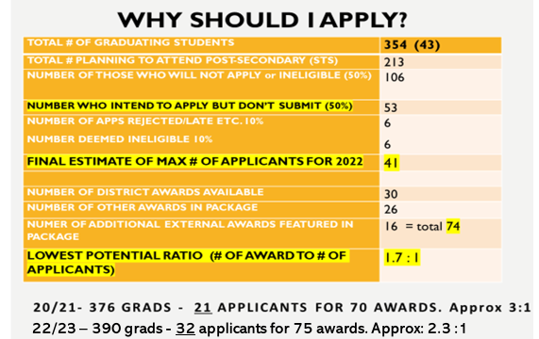
23/24 360 grads, 36 applicants for 73 awards. Approx 2 : 1

Slide 31
Fall 2025 Application Timeline - BC Schools
MOST APPLICATION PORTALS WILL OPEN OCT 1ST
Apply via Education Planner BC Application system (create account)
Douglas College – Applications OPEN Oct. 3 Apply for limited entry right away
SFU – Applications OPEN Oct. 1
SFU USES Entrance Scholarship deadline Dec.15
SFU Application deadline is Jan 31
UBC – Early Application Deadline is Dec. 1 to be considered for the UBC Major Entrance Scholarships. Final Deadline TO APPLY is Jan. 15
UVic –Application deadline is November 30 (new*earlier)
Capilano U - Entrance Awards deadline March 1, 2025. 1.9 million last year (holistic)
BCIT – Applications open Oct 1 until full or by deadline date. Apps for trades programs accepted all year. (rotating). BCIT is now on Education Planner.
(Many BCIT programs are competitive. Apply early! Double check- some programs do not accept direct high school applicants & require post-secondary credits to apply)

Slide 32
Out-of-Province Applications
Universities in Alberta –https://www.applyalberta.ca/pub/
OUAC Ontario University Application Center–
apply EARLY (November for U of T) Go to www.ouac.on.ca/ouac-105/ (OPEN Now – create your account)
USA College Applications via the Common App Apply to college with Common App | Your future starts here

Slide 33

Reminder:
Deadlines are set in STONE !!
Do not ignore them!
    College & University application deadlines
    Online/Distance course completion deadlines
    Standardized test deadlines TOEFL, SAT, IELTS etc.
    Transcript request deadlines: BCeID#, STS deadlines (Reminder- If you apply to additional schools, you must log back in and update you student transcript selections!!) Not sure? Ask Me!
    Internal deadlines set by your school! Forms close automatically!

Slide 34
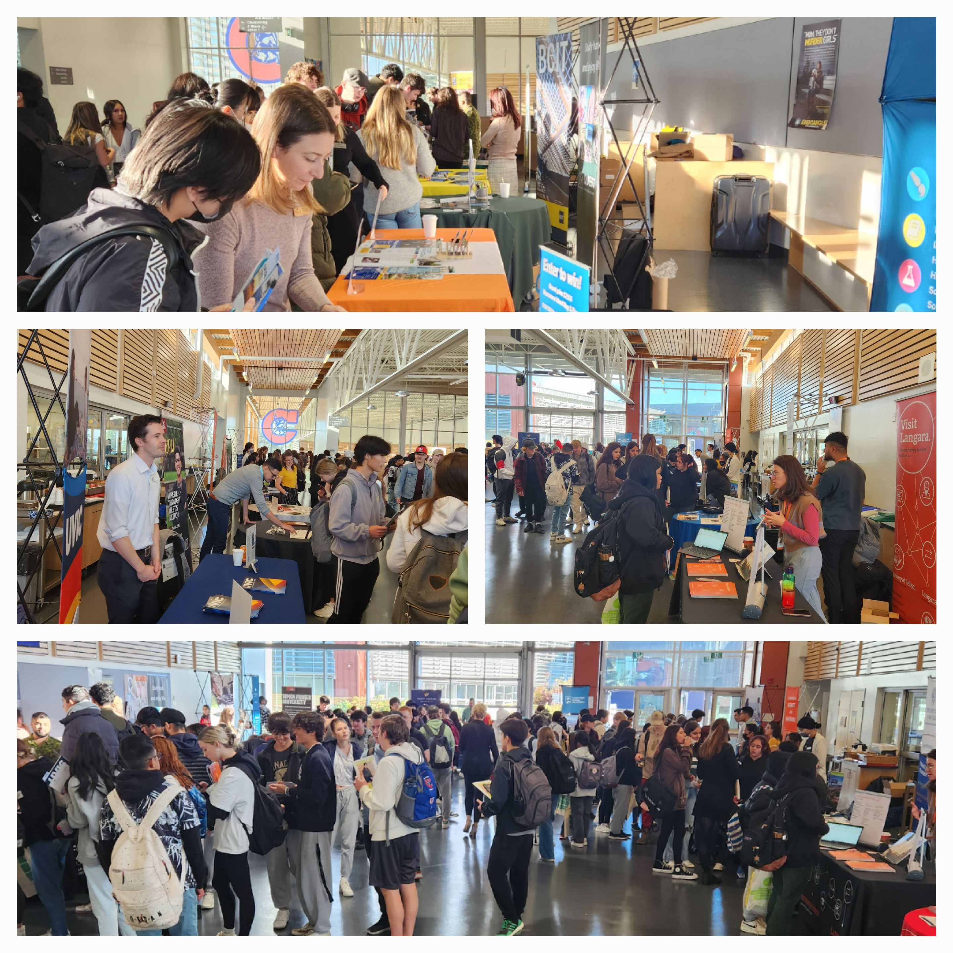
Upcoming EVENTS
Douglas Campus Info Fair New West Campus Oct 29th
U of Alberta Oct 7th at Centennial/flex BCIT BIG INFO OCT 9th 4-7 pm Burnaby Campus
BCIT BIG INFO – Oct 9th Burnaby Campus
PSBC FAIR OCT 21st 9-11 AM at Centennial Gr. 11/12’s
SFU Beedie at Centennial Oct 16 at lunch
VCC Info Week Oct 21-25
Douglas College Info session November 20 at Centennial
Explore CapU Open House Nov 30th
VCC Info Week Oct 21-25
More being added regularly:
Career Centre - Centennial Secondary School (sd43.bc.ca)

Slide 35

Good Luck!
Thanks for attending!
The next scholarship meeting Thurs. Feb 13th
-Local Scholarship application package & District/Community awards.

